Slide 2
Exploratory Data Analysis of
Large-Scale Retail Transaction Data
Using Univariate, Bivariate & Multivariate Statistical Techniques
Prepared by Suresh Kumar
NextHikes IT Solutions | September 2026

Slide 3
1. Introduction & Project Objective
EDA summarizes, visualizes and understands data before predictive modeling.
Analyze 100,000 retail transactions and 18 variables.
Perform Univariate, Bivariate and Multivariate analysis.
Detect outliers; measure Pearson correlation; analyze skewness and kurtosis.
Extract statistically meaningful business insights.
NextHikes IT Solutions | Retail EDA | 2

Slide 4
2. Dataset Overview
Rows: 100,000
Columns: 18
Data types: Numerical, Categorical and Date
Missing values: 0
Duplicate rows: 0
Core measures: age, product_price, quantity, discount_percentage, final_price and delivery_days
Business dimensions: category, segment, payment, shipping and return status
NextHikes IT Solutions | Retail EDA | 3

Slide 5
3. EDA Methodology
Data validation → missing values, duplicates and date conversion.
Univariate → mean, median, standard deviation, min/max, skewness and kurtosis.
Bivariate → frequency distributions, category comparisons and Pearson correlation.
Multivariate → interactions among segment, age, category, discount, spending, delivery and returns.
Outliers → boxplot, IQR and Z-score.
NextHikes IT Solutions | Retail EDA | 4

Slide 6
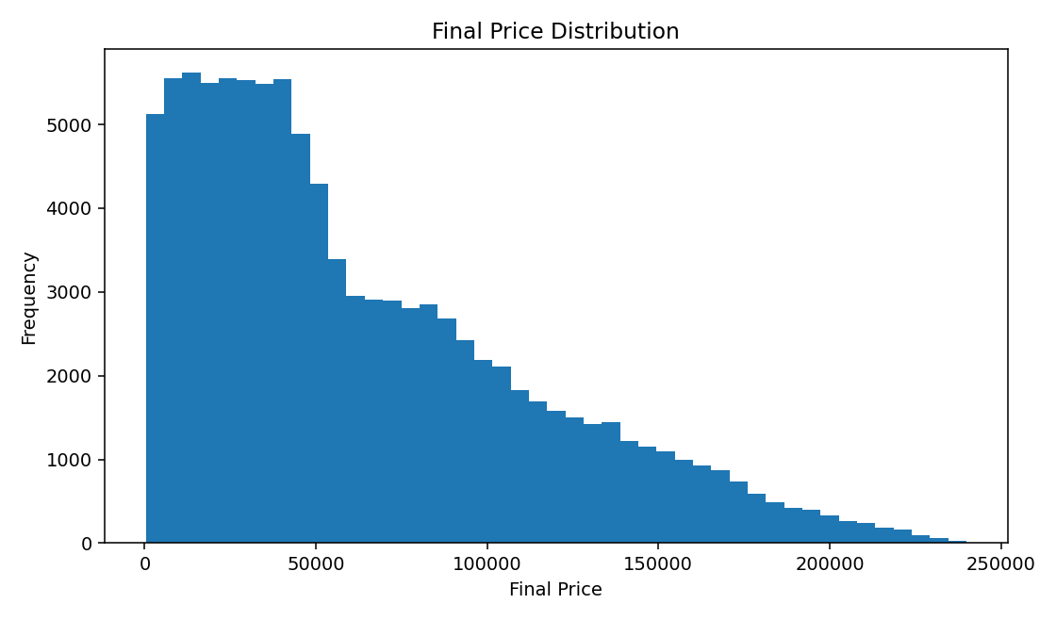
4. Final Price Distribution
Key insight
Right-skewed distribution: mean ₹64,165.72 is above median ₹49,752.39.
NextHikes IT Solutions | Retail EDA | 5

Slide 7
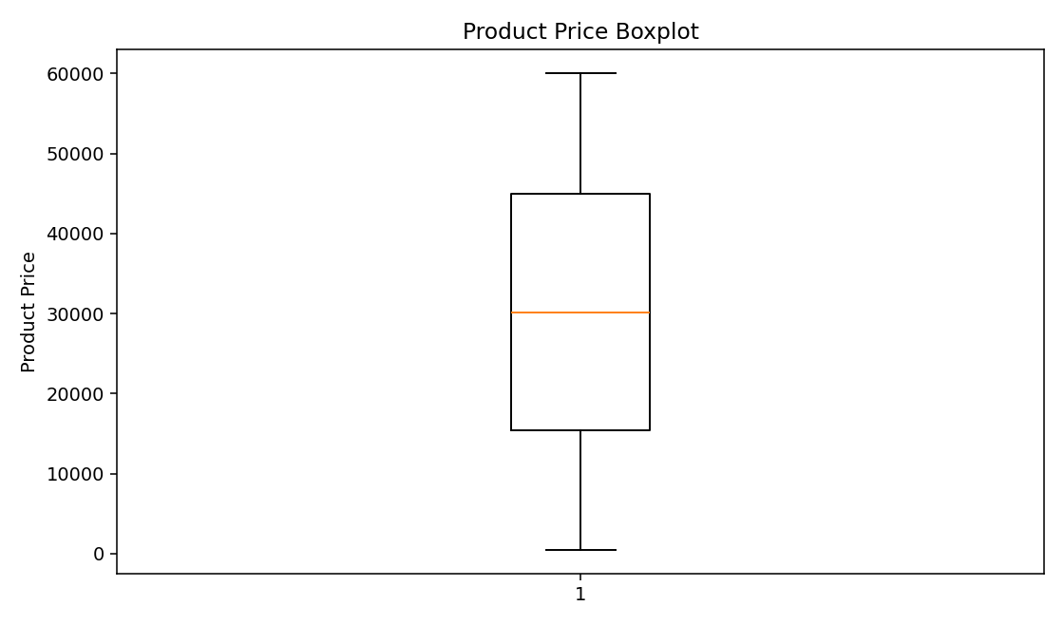
5. Product Price — Outlier Detection
Key insight
Boxplot highlights spread and potential high-value observations; they were not automatically removed.
NextHikes IT Solutions | Retail EDA | 6

Slide 8
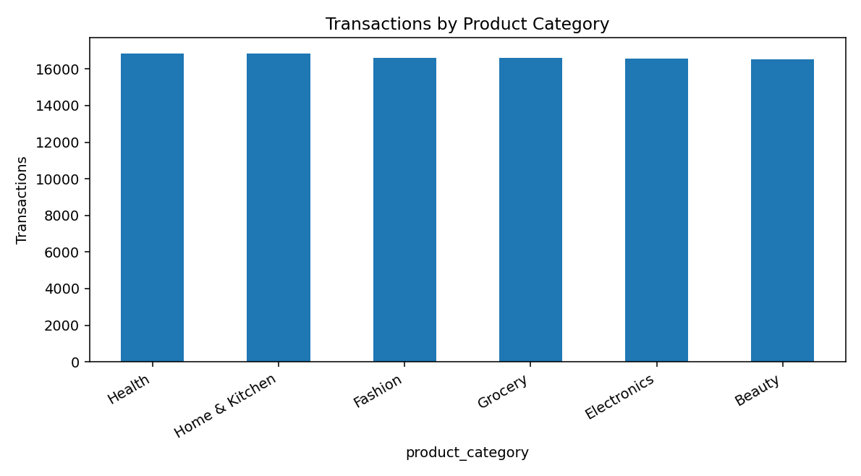
6. Transactions by Product Category
Key insight
Category transaction volume supports comparisons of revenue, pricing and return behavior.
NextHikes IT Solutions | Retail EDA | 7

Slide 9
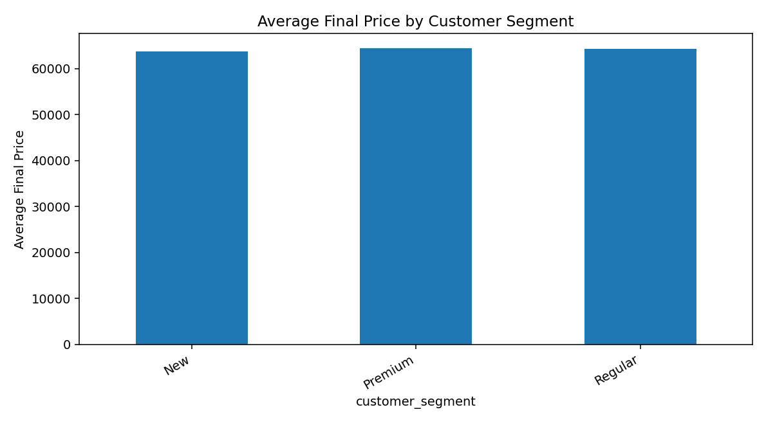
7. Average Spending by Customer Segment
Key insight
Premium customers have the highest average final price: ₹64,430.45.
NextHikes IT Solutions | Retail EDA | 8

Slide 10
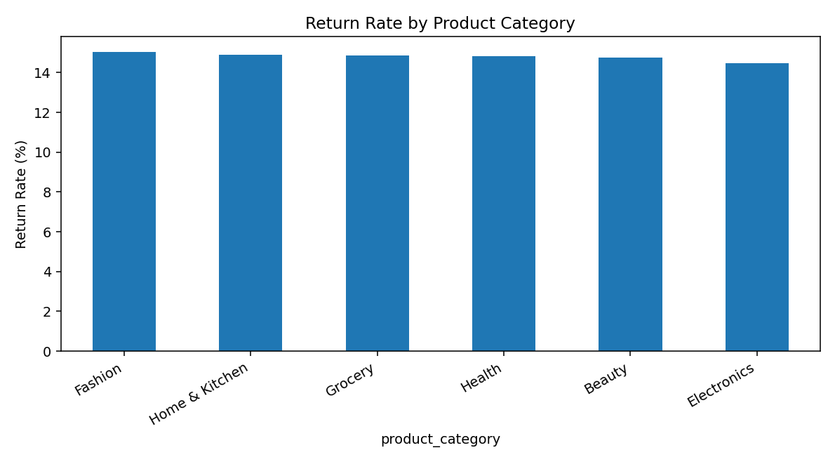
8. Return Rate by Product Category
Key insight
Fashion has the highest measured return rate: 15.05%.n
NextHikes IT Solutions | Retail EDA | 9

Slide 11
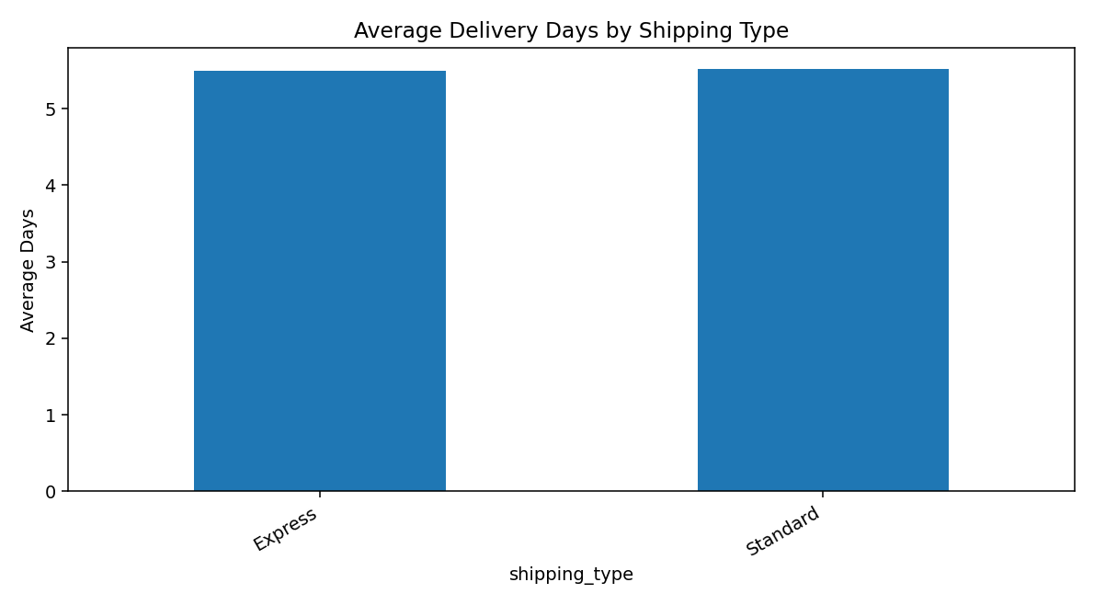
9. Delivery Days by Shipping Type
Key insight
Express and Standard are almost identical: 5.50 vs 5.51 days.
NextHikes IT Solutions | Retail EDA | 10

Slide 12
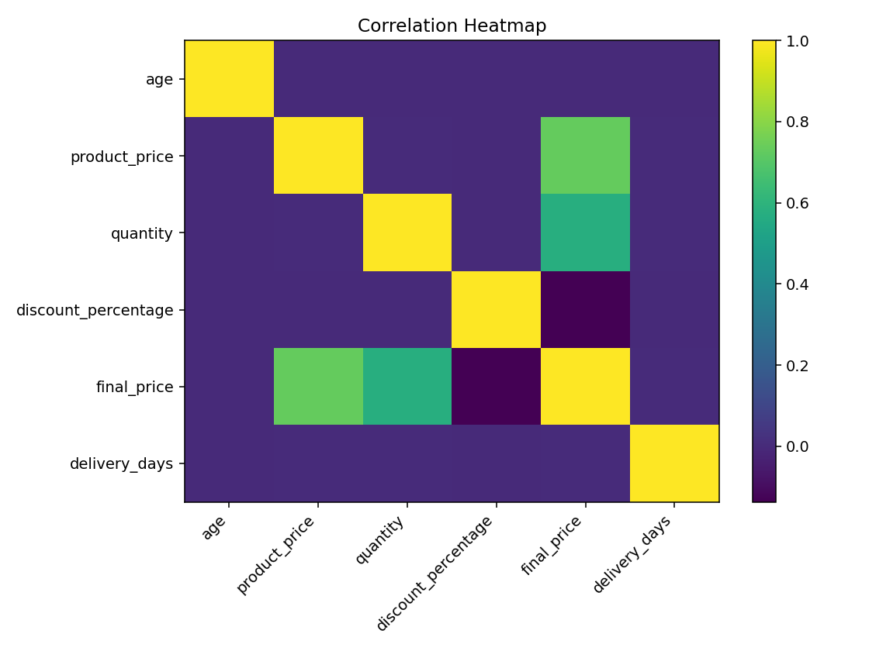
10. Correlation Heatmap
Key insight
Final price correlation: product price 0.731; quantity 0.575.
NextHikes IT Solutions | Retail EDA | 11

Slide 13
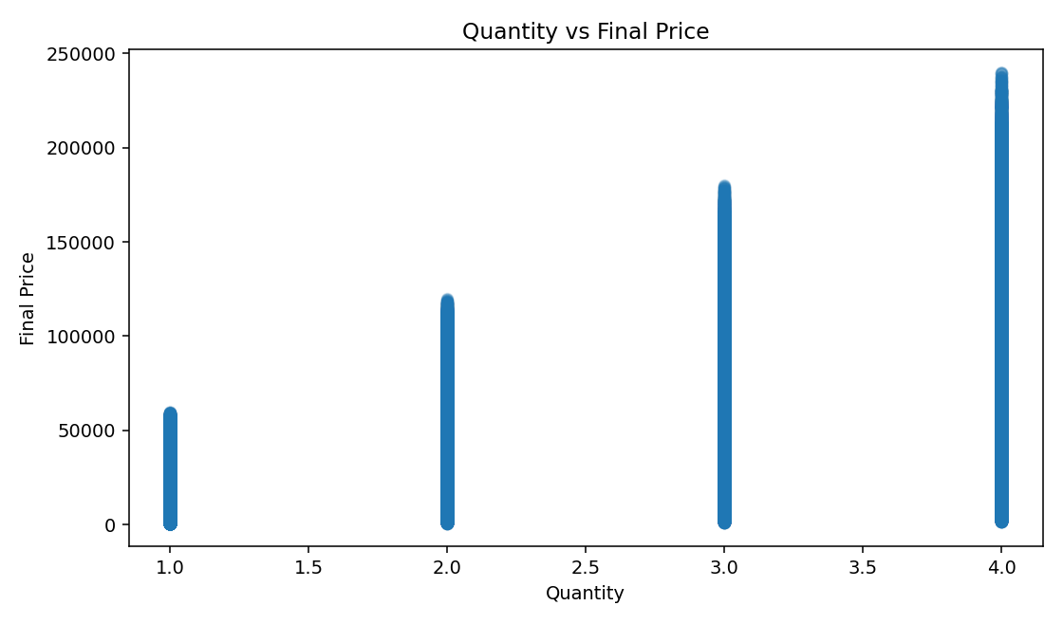
11. Quantity vs Final Price
Key insight
Quantity and final price have Pearson correlation 0.575.
NextHikes IT Solutions | Retail EDA | 12

Slide 14
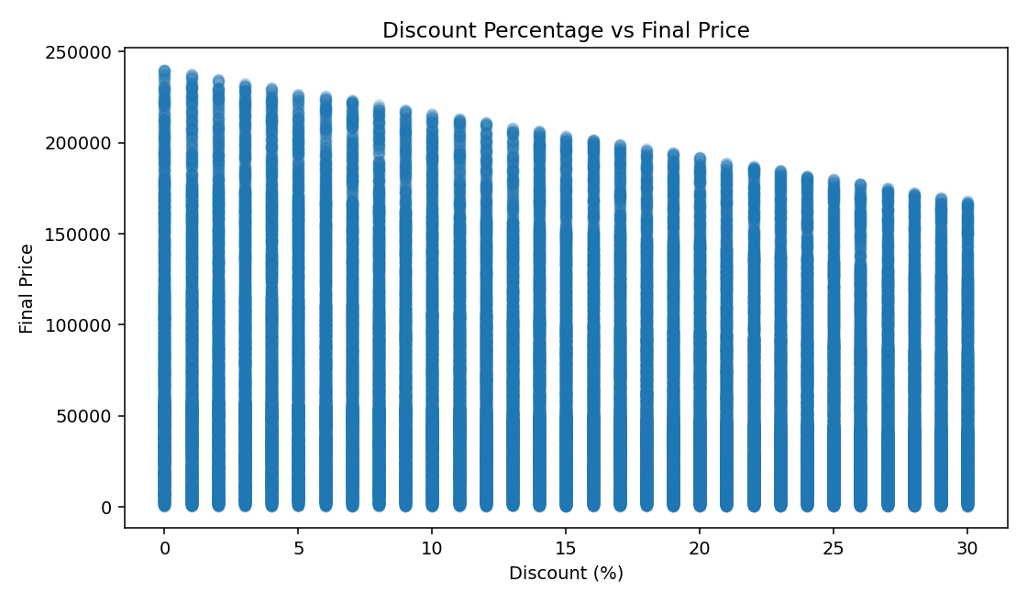
12. Discount vs Final Price
Key insight
Discount percentage has correlation -0.137 with final price.
NextHikes IT Solutions | Retail EDA | 13

Slide 15
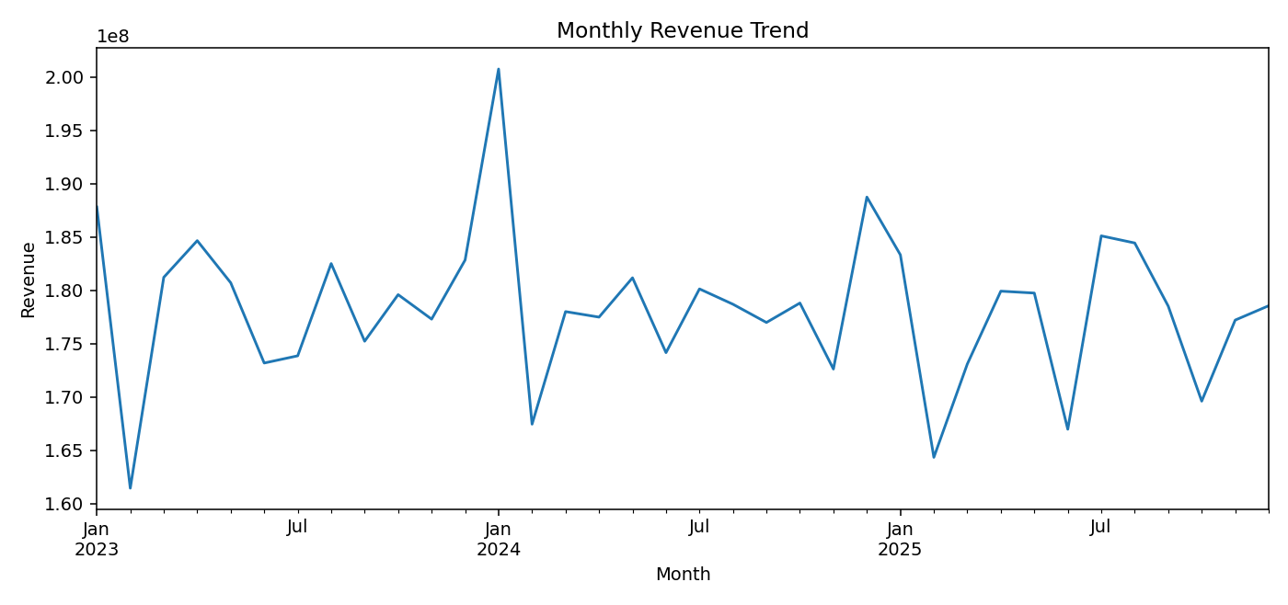
13. Monthly Revenue Trend
Key insight
Monthly transaction value provides a time-based view of revenue movement.
NextHikes IT Solutions | Retail EDA | 14

Slide 16
14. Key Statistical Findings
Total transaction value: ₹6,416,572,338.24
Average final price: ₹64,165.72 | Median: ₹49,752.39
Overall return rate: 14.81%
Product price ↔ final price: r=0.731
Quantity ↔ final price: r=0.575
Delivery days ↔ return status: r=0.001
Final price has positive skewness and positive kurtosis.
NextHikes IT Solutions | Retail EDA | 15

Slide 17
15. Business Insights & Conclusion
Revenue is strongly associated with product price and quantity.
High-value observations should be investigated rather than automatically removed.
Category-level return rates should be monitored separately.
Delivery days and return status show almost no linear relationship.
EDA provides a foundation for segmentation, pricing, operations and predictive modeling.
All findings are calculated from the supplied 100,000-row dataset.
NextHikes IT Solutions | Retail EDA | 16

Slide 18
THANK YOU
Exploratory Data Analysis of Large-Scale Retail Transaction Data
Prepared by Suresh Kumar
NextHikes IT Solutions

